Slide 1
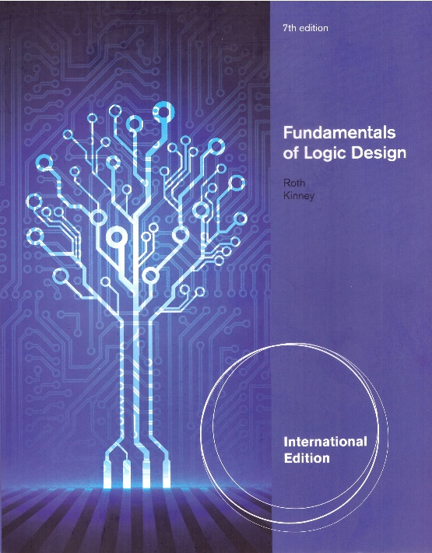
Unit 15
Reduction of State Tables and State Assignment
This chapter in the book includes:
Objectives
Study Guide
15.1 Elimination of Redundant States
15.2 Equivalent States
15.3 Determination of State Equivalence Using an Implication Table
15.4 Equivalent Sequential Circuits
15.5 Incompletely Specified State Tables
15.6 Derivation of Flip-Flop Input Equations
15.7 Equivalent State Assignments
15.8 Guidelines for State Assignment
15.9 Using a One-Hot State Assignment
Problems

Slide 2
Objectives
Define equivalent states, state several ways of testing for state equivalence,
and determine if two states are equivalent.
Define equivalent sequential circuits and determine
if two circuits are equivalent.
Reduce a state table to a minimum number of rows.
Specify a suitable set of state assignments for a state table,
eliminating those assignments which are equivalent with respect
to the cost of realizing the circuit
State three guidelines which are useful in making state assignments,
and apply these to making a good state assignment for a given state table
Given a state table and assignment, form the transition table and
derive flip-flop input equations
Make a one-hot state assignment for a state graph and write the next state
and output equations by inspection.

Slide 3
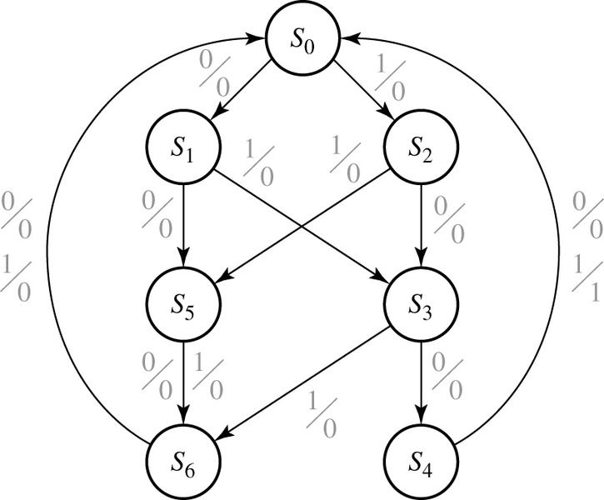
15.1 Elimination of Redundant States
Example: Sequence Detector ㅡ 14.3 Mealy 0101 or 1001
X = | 0101 | 0010 | 1001 | 0100
Z = | 0001 | 0000 | 0001 | 0000
state | sequence received
S₀ S₁ S₂ S₃ S₄ S₅ S₆ | Reset 0 1 01 or 10 010 or 100 two inputs received, no 1 output is possible three inputs received, no 1 output is possible

Slide 4
15.1 Elimination of Redundant States
Table 15-1: State Table for Sequence Detector Mealy 0101 or 1001
Input Sequence | Present State | Next State |  | Present Output
 |  | X=0 | X=1 | X=0 | X=1
reset | A | B | C | 0 | 0
0 | B | D | E | 0 | 0
1 | C | F | G | 0 | 0
00 | D | H | I | 0 | 0
01 | E | J | K | 0 | 0
10 | F | L | M | 0 | 0
11 | G | N | P | 0 | 0
000 | H | A | A | 0 | 0
001 | I | A | A | 0 | 0
010 | J | A | A | 0 | 1
011 | K | A | A | 0 | 0
100 | L | A | A | 0 | 1
101 | M | A | A | 0 | 0
110 | N | A | A | 0 | 0
111 | P | A | A | 0 | 0

Slide 5
15.1 Elimination of Redundant States
Table 15-1: State Table for Sequence Detector Mealy 0101 or 1001
Input Sequence | Present State | Next State |  | Present Output
 |  | X=0 | X=1 | X=0 | X=1
reset | A | B | C | 0 | 0
0 | B | D | E | 0 | 0
1 | C | F | G | 0 | 0
00 | D | H | I | 0 | 0
01 | E | J | K | 0 | 0
10 | F | L | M | 0 | 0
11 | G | N | P | 0 | 0
000 | H | A | A | 0 | 0
001 | I | A | A | 0 | 0
010 | J | A | A | 0 | 1
011 | K | A | A | 0 | 0
100 | L | A | A | 0 | 1
101 | M | A | A | 0 | 0
110 | N | A | A | 0 | 0
111 | P | A | A | 0 | 0

Slide 6
15.1 Elimination of Redundant States
Table 15-1: State Table for Sequence Detector Mealy 0101 or 1001
Input Sequence | Present State | Next State |  | Present Output
 |  | X=0 | X=1 | X=0 | X=1
reset | A | B | C | 0 | 0
0 | B | D | E | 0 | 0
1 | C | F | G | 0 | 0
00 | D | H | I | 0 | 0
01 | E | J | K | 0 | 0
10 | F | L | M | 0 | 0
11 | G | N | P | 0 | 0
000 | H | A | A | 0 | 0
001 | I | A | A | 0 | 0
010 | J | A | A | 0 | 1
011 | K | A | A | 0 | 0
100 | L | A | A | 0 | 1
101 | M | A | A | 0 | 0
110 | N | A | A | 0 | 0
111 | P | A | A | 0 | 0
H
H = I
equivalent

Slide 7
15.1 Elimination of Redundant States
Table 15-1: State Table for Sequence Detector Mealy 0101 or 1001
Input Sequence | Present State | Next State |  | Present Output
 |  | X=0 | X=1 | X=0 | X=1
reset | A | B | C | 0 | 0
0 | B | D | E | 0 | 0
1 | C | F | G | 0 | 0
00 | D | H | I | 0 | 0
01 | E | J | K | 0 | 0
10 | F | L | M | 0 | 0
11 | G | N | P | 0 | 0
000 | H | A | A | 0 | 0
001 | I | A | A | 0 | 0
010 | J | A | A | 0 | 1
011 | K | A | A | 0 | 0
100 | L | A | A | 0 | 1
101 | M | A | A | 0 | 0
110 | N | A | A | 0 | 0
111 | P | A | A | 0 | 0
H
H
H
H
H
K, M, N, P = I = J
equivalent

Slide 8
15.1 Elimination of Redundant States
Table 15-1: State Table for Sequence Detector Mealy 0101 or 1001
Input Sequence | Present State | Next State |  | Present Output
 |  | X=0 | X=1 | X=0 | X=1
reset | A | B | C | 0 | 0
0 | B | D | E | 0 | 0
1 | C | F | G | 0 | 0
00 | D | H | I | 0 | 0
01 | E | J | K | 0 | 0
10 | F | L | M | 0 | 0
11 | G | N | P | 0 | 0
000 | H | A | A | 0 | 0
001 | I | A | A | 0 | 0
010 | J | A | A | 0 | 1
011 | K | A | A | 0 | 0
100 | L | A | A | 0 | 1
101 | M | A | A | 0 | 0
110 | N | A | A | 0 | 0
111 | P | A | A | 0 | 0
H
H
J
H
H
H
J = L
equivalent

Slide 9
15.1 Elimination of Redundant States
Table 15-1: State Table for Sequence Detector Mealy 0101 or 1001
Input Sequence | Present State | Next State |  | Present Output
 |  | X=0 | X=1 | X=0 | X=1
reset | A | B | C | 0 | 0
0 | B | D | E | 0 | 0
1 | C | F | G | 0 | 0
00 | D | H | I | 0 | 0
01 | E | J | K | 0 | 0
10 | F | L | M | 0 | 0
11 | G | N | P | 0 | 0
000 | H | A | A | 0 | 0
001 | I | A | A | 0 | 0
010 | J | A | A | 0 | 1
011 | K | A | A | 0 | 0
100 | L | A | A | 0 | 1
101 | M | A | A | 0 | 0
110 | N | A | A | 0 | 0
111 | P | A | A | 0 | 0
H
H
D = G
equivalent
J
H
H
H

Slide 10
15.1 Elimination of Redundant States
Table 15-1: State Table for Sequence Detector Mealy 0101 or 1001
Input Sequence | Present State | Next State |  | Present Output
 |  | X=0 | X=1 | X=0 | X=1
reset | A | B | C | 0 | 0
0 | B | D | E | 0 | 0
1 | C | F | G | 0 | 0
00 | D | H | I | 0 | 0
01 | E | J | K | 0 | 0
10 | F | L | M | 0 | 0
11 | G | N | P | 0 | 0
000 | H | A | A | 0 | 0
001 | I | A | A | 0 | 0
010 | J | A | A | 0 | 1
011 | K | A | A | 0 | 0
100 | L | A | A | 0 | 1
101 | M | A | A | 0 | 0
110 | N | A | A | 0 | 0
111 | P | A | A | 0 | 0
H
H
E = F
equivalent
J
H
H
H

Slide 11
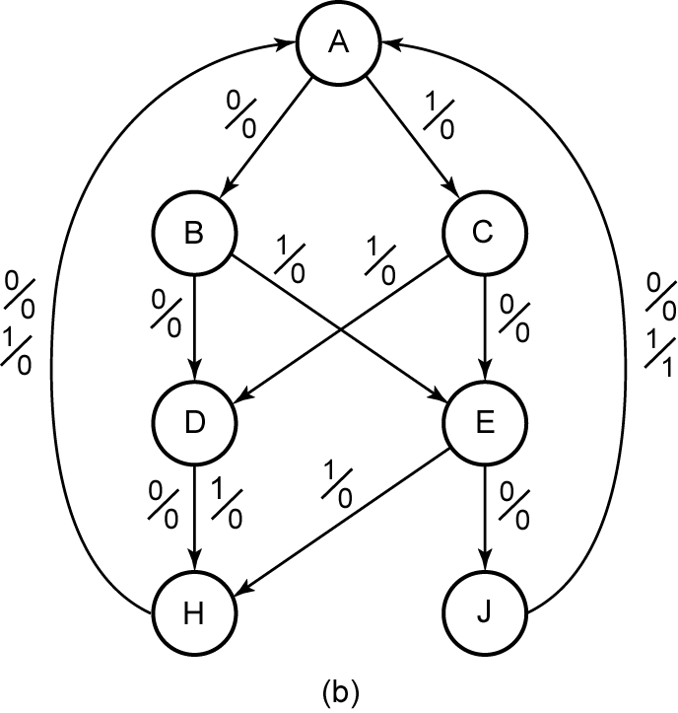
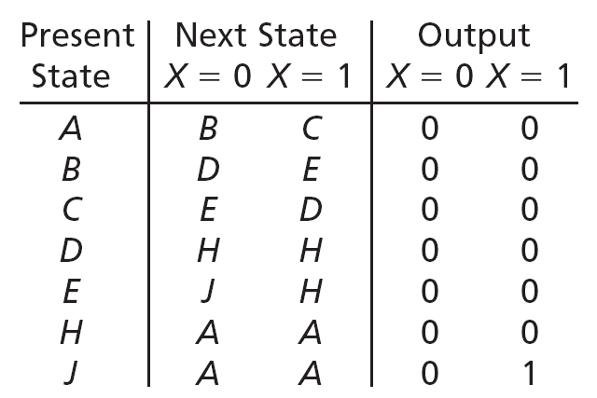
15.1 Elimination of Redundant States
Figure 15-1a: Reduced State Table for Sequence Detector Mealy 0101 or 1001

Slide 12
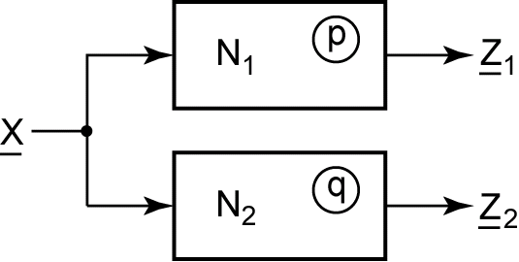
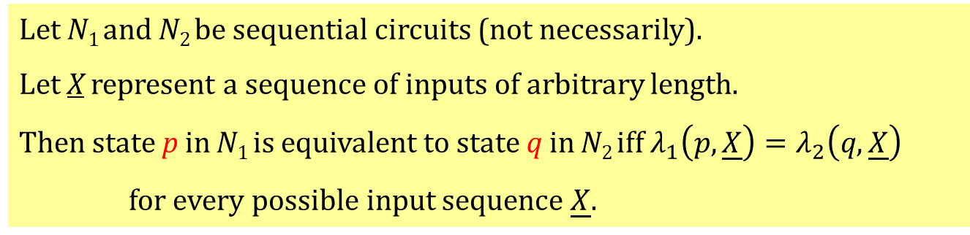
15.2 Equivalent States
Fig 15-2
Theorem 15.1
Let N₁ and N₂ be sequential circuits (not necessarily).
Let X represent a sequence of inputs of arbitrary length.
Then state p in N₁ is equivalent to state q in N₂ iff $λ_{1}\left(p,\underline{X}\right)=λ_{2}\left(q,\underline{X}\right)$
for every possible input sequence $\underline{X}$.
Notes:
12

Slide 13
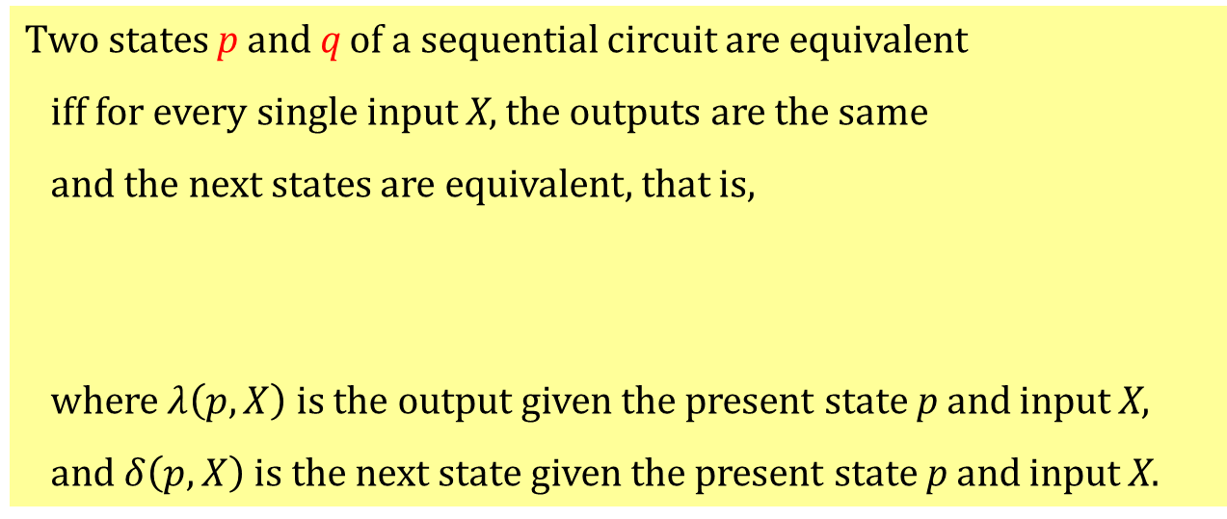
15.2 Equivalent States
Theorem 15.1
Two states p and q of a sequential circuit are equivalent
iff for every single input X, the outputs are the same
and the next states are equivalent, that is,
where $λ\left(p,X\right)$ is the output given the present state p and input X,
and $δ\left(p,X\right)$ is the next state given the present state p and input X.

Slide 14
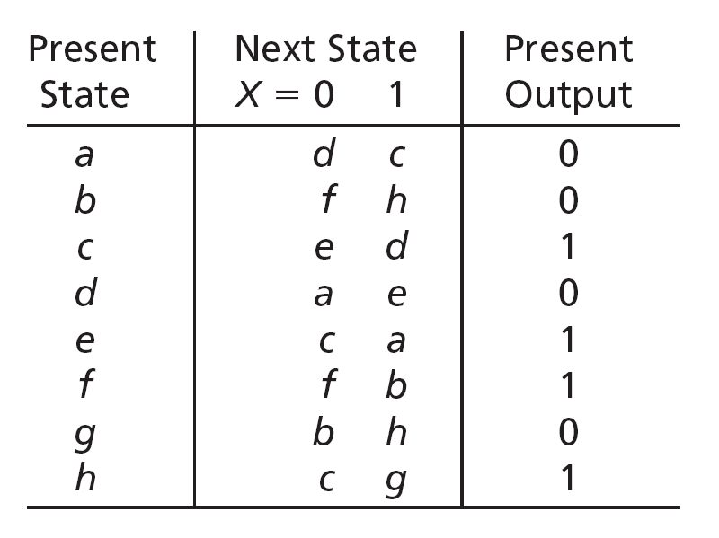
15.3 Determination of Equivalent States
Table 15-3
a ≡ b iff
d ≡ f and c ≡ h
a ≡ d iff
a ≡ d and c ≡ e
a ≡ g iff
b ≡ d and c ≡ h

Slide 15
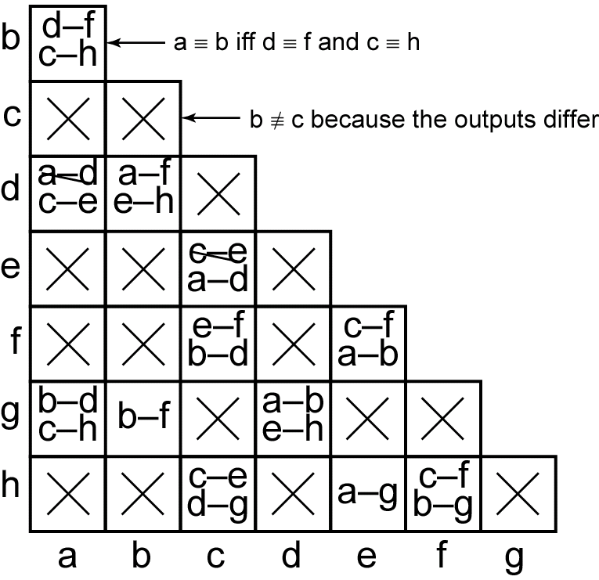
15.3 Determination of Equivalent States
Figure 15-3 Implication Chart for Table 15-3

Slide 16
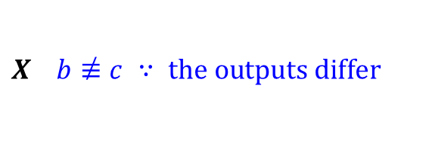
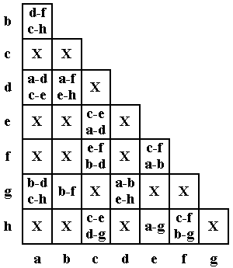
15.3 Determination of Equivalent States
$$X b\overset{̸}{≡}c ∵ \text{the} \text{outputs} \text{differ}$$
Self-implied Pairs
State Table 15-3
Implication (Pair) Chart for Table 15-3

Slide 17

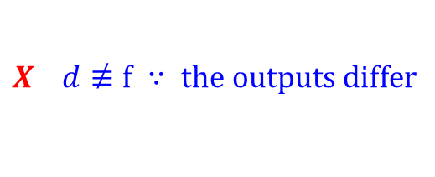
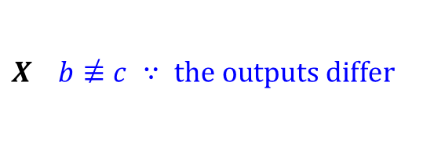
15.3 Determination of Equivalent States
$$X$$
$$X b\overset{̸}{≡}c ∵ \text{the} \text{outputs} \text{differ}$$
Self-implied Pairs
$$X d\overset{̸}{≡}f ∵ \text{the} \text{outputs} \text{differ}$$
State Table 15-3
Implication (Pair) Chart for Table 15-3

Slide 18
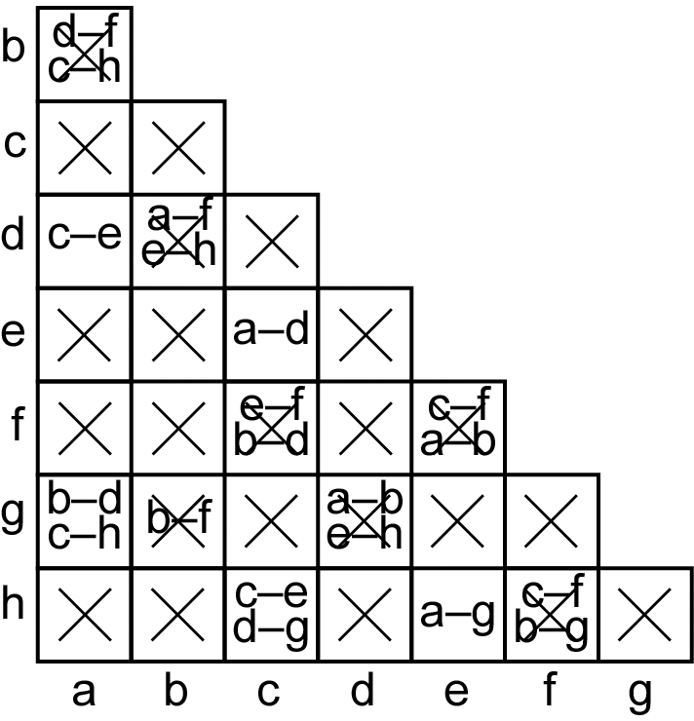
15.3 Determination of Equivalent States
Figure 15-4 Implication (Pair) Chart After First Pass

Slide 19
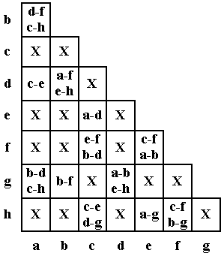
15.3 Determination of Equivalent States
d≠f, ∴ a≠b

Slide 20
15.3 Determination of Equivalent States

Slide 21
15.3 Determination of Equivalent States

Slide 22
15.3 Determination of Equivalent States

Slide 23
15.3 Determination of Equivalent States

Slide 24
15.3 Determination of Equivalent States

Slide 25
15.3 Determination of Equivalent States

Slide 26
15.3 Determination of Equivalent States

Slide 27
15.3 Determination of Equivalent States

Slide 28
15.3 Determination of Equivalent States

Slide 29
15.3 Determination of Equivalent States
a ≡ d and c ≡ e

Slide 30
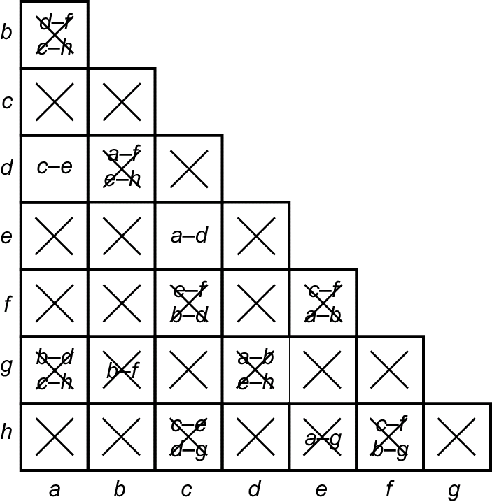
15.3 Determination of Equivalent States
Figure 15-5: Implication (Pair) Chart After Second Pass

Slide 31
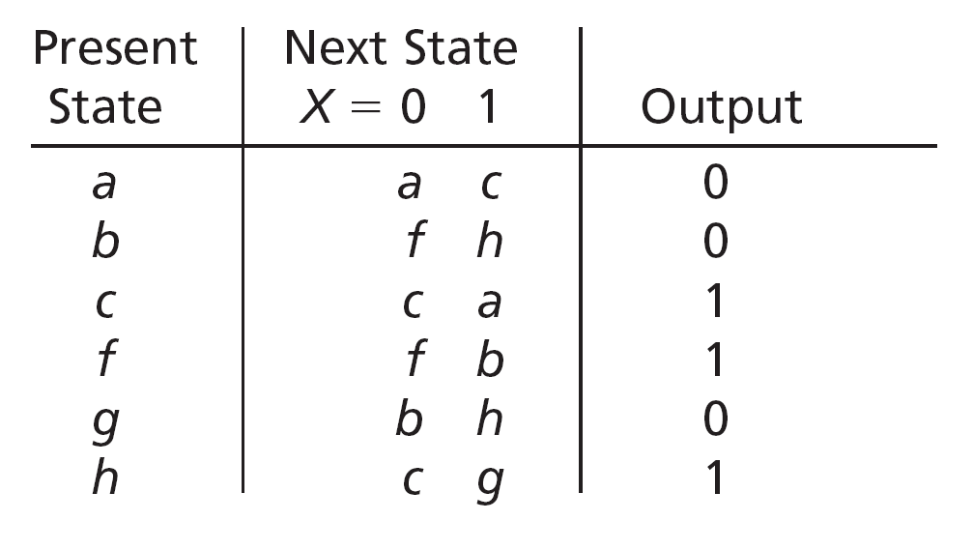
15.3 Determination of Equivalent States
Table 15-4
d is replaced with a
e is replaced with c
d and e are removed

Slide 32
15.3 Determination of Equivalent States
Implication Table Method:
Construct a chart which contains a square for each pair of states.
2. Compare each pair of rows in the state table. If the outputs associated with states i and j are different, place an X in square i-j to indicate that i ≡ j. If the outputs are the same, place the implied pairs in square i-j. (If the next states of i and j are m and n for some input x, then m-n is an implied pair.) If the outputs and next states are the same (or if i-j only implies itself), place a check (√) in square i-j to indicate that i ≡ j.
3. Go through the table square-by-square. If square i-j contains the implied pair m-n, and square m-n contains an X, then i ≡ j, and X should be placed in square i-j.
4. If any X’s were added in step 3, repeat step 3 until no more X’s are added.
5. For each square i-j which does not contain an X, i ≡ j.
The implication table method of determining state equivalence can be summarized as follows:

Slide 33
15.4 Equivalent Sequential Circuits
Definition 15.2
Sequential circuit N₁ is equivalent to sequential circuit N₂ if for each state p in N₁, there is a state q in N₂ such that p ≡ q, and conversely, for each state s in N₂, there is a state t in N₁ such that s ≡ t.
Notes:
33

Slide 34
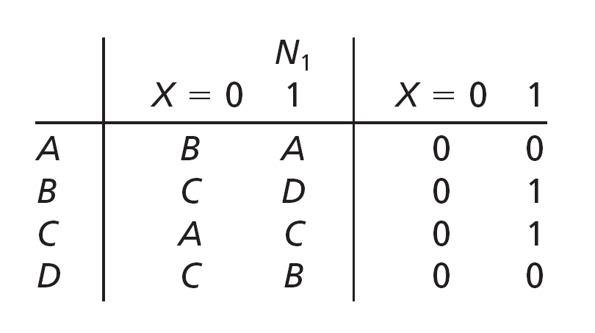
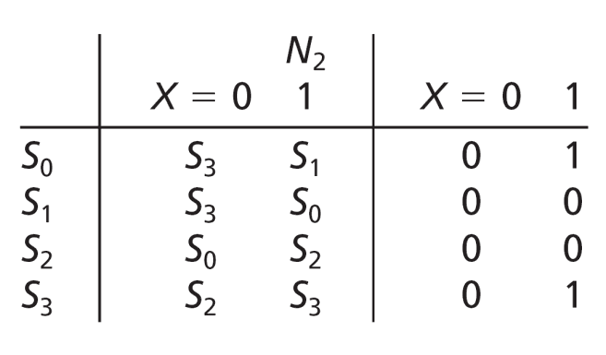
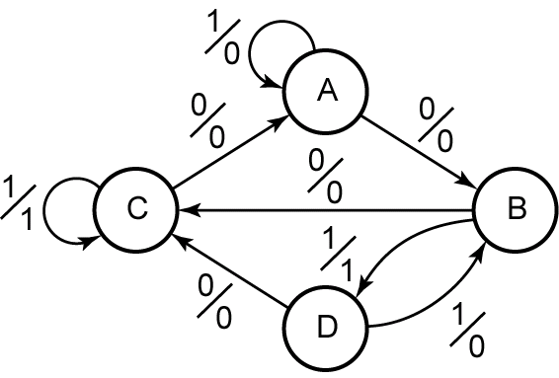
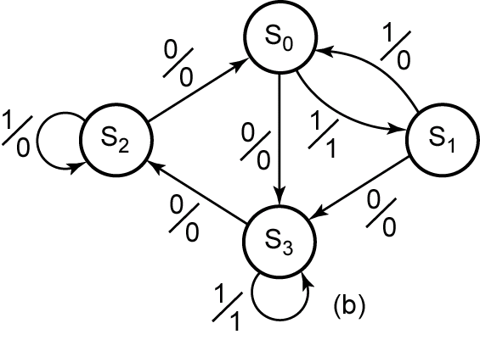
15.4 Equivalent Sequential Circuits
Figure 15-6 Graphs for Equivalent Circuits
Notes:
34

Slide 35
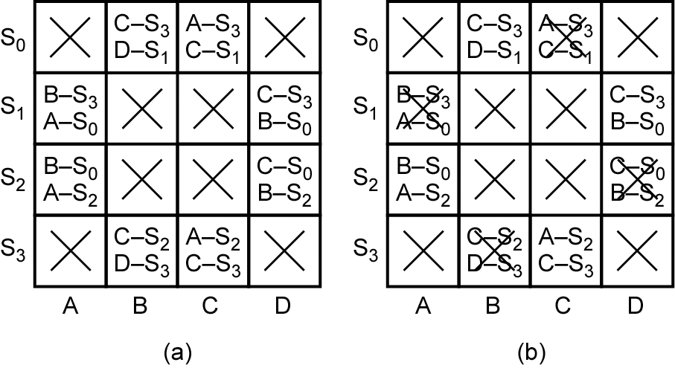
15.4 Equivalent Sequential Circuits
Figure 15-7 Implication Tables for Determining Circuit Equivalence
Notes:
35

Slide 36
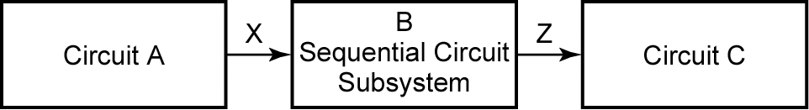
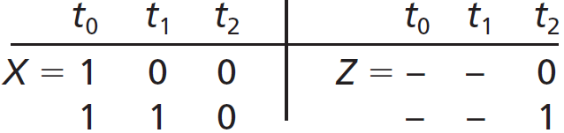

15.5 Incompletely Specified State Tables
Figure 15-8
Assume that circuit A can only generate two possible output sequences, X = 100 and X = 110. Thus, the sequential circuit subsystem (B) has only two possible input sequences. Also, C only reads Z during everything third input.
Notes:
36

Slide 37
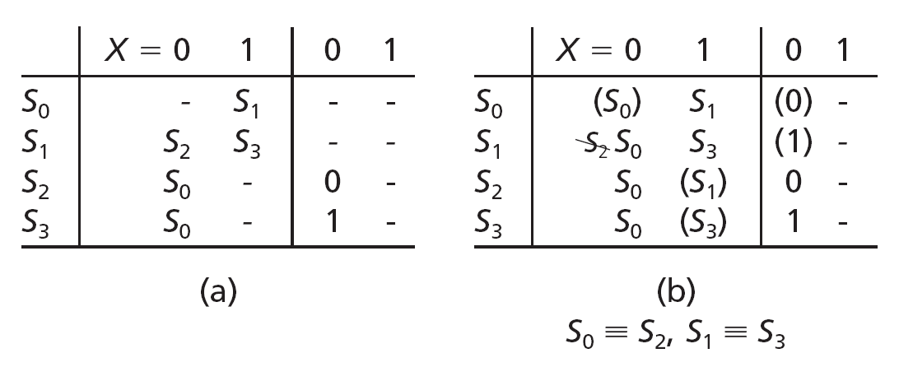
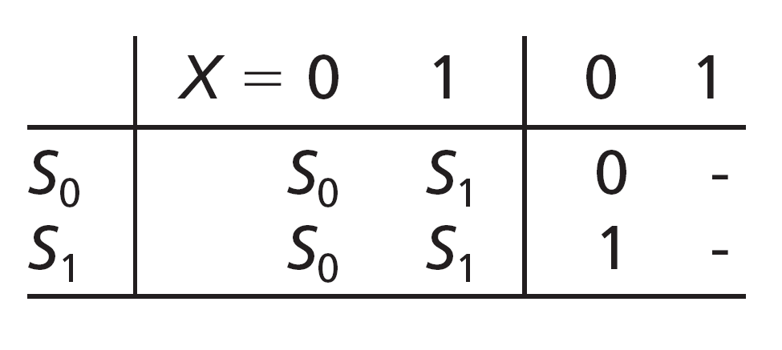
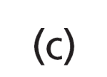
15.5 Incompletely Specified State Tables
Table 15-5 Incompletely Specified State Table
Notes:
37

Slide 38
15.6 Derivation of FF Input Equations
To derive the flip-flop input equations:
1. Assign flip-flop state values to correspond to the states in the reduced table.
2. Construct a transition table which gives the next states of the flip-flops as a function of the present states and inputs.
3. Derive the next-state maps from the transition table.
4. Find flip-flop input maps from the next-state maps using the techniques developed in Unit 12 and find the flip-flop input equations from the maps.
Notes:
38

Slide 39
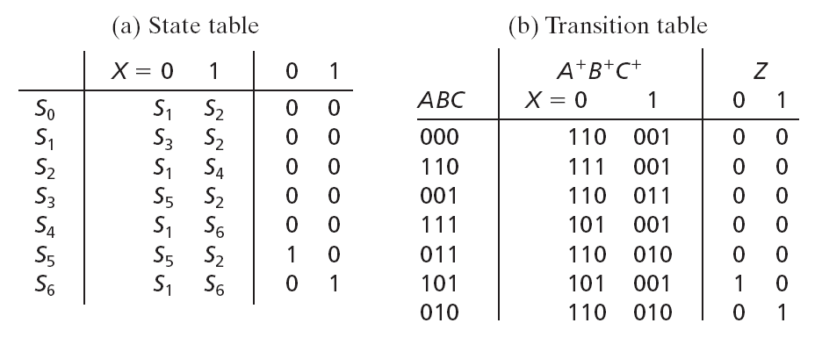
15.6 Derivation of FF Input Equations
Example #1: Derivation of FF Input Equations (Table 15-6)
Assign flip-flop state values to correspond to the states in the reduced table.
Construct a transition table which gives the next states of the flip-flops as a function of the present states and inputs.

Slide 40
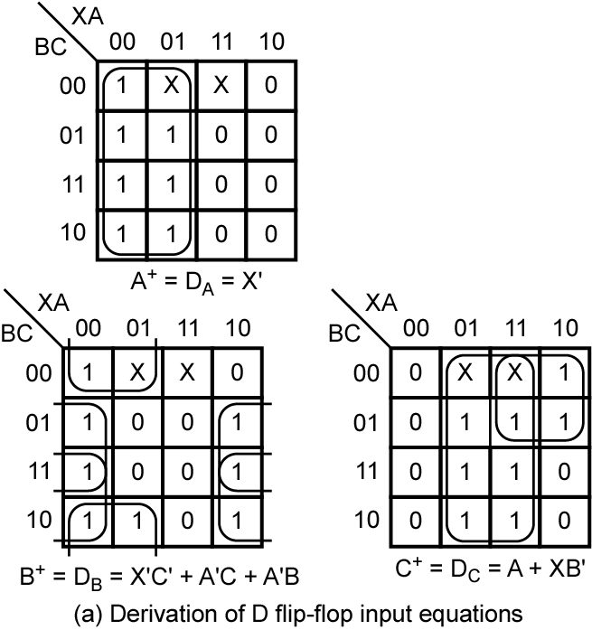
15.6 Derivation of FF Input Equations
Example #1: Derivation of FF Input Equations (Figure 15-9 (a))
D FF Characteristic Equation:
Q⁺ = D
3. Derive the next-state maps from the transition table.

Slide 41
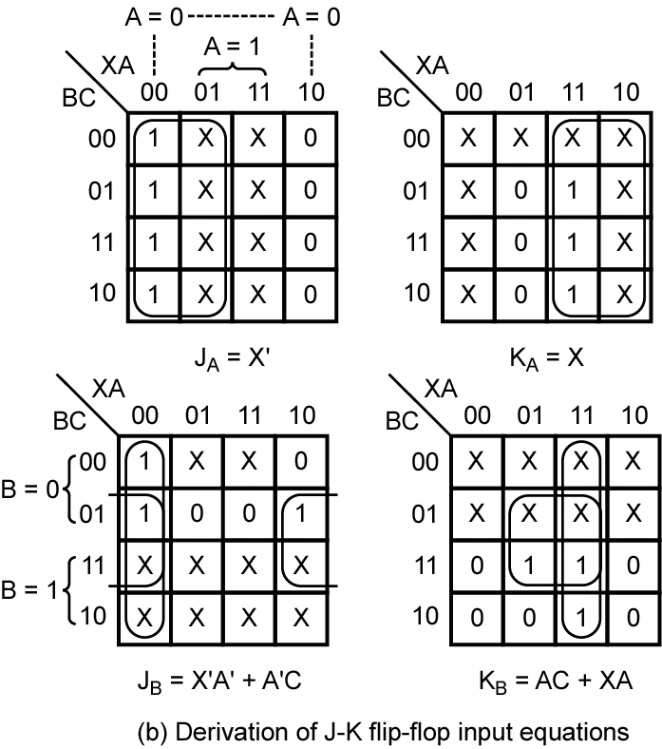
15.6 Derivation of FF Input Equations
Example #1: Derivation of FF Input Equations (Figure 15-9 (b))
JK Excitation Table
Q | Q+ | J | K
0 | 0 | 0 | x
0 | 1 | 1 | x
1 | 0 | x | 1
1 | 1 | x | 0
4. Derive the flip-flop input maps from the next-state maps;
determine the flip-flop input equations from the FF input maps.

Slide 42
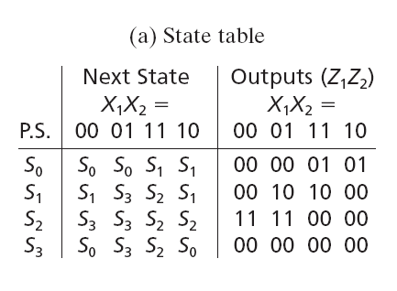
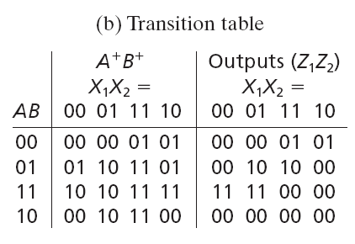
15.6 Derivation of FF Input Equations
Example #2: Derivation of FF Input Equations (Table 15-7)
Assign flip-flop state values to correspond to the states in the reduced table.
Construct a transition table which gives the next states of the flip-flops as a function of the present states and inputs.
Notes:
42

Slide 43
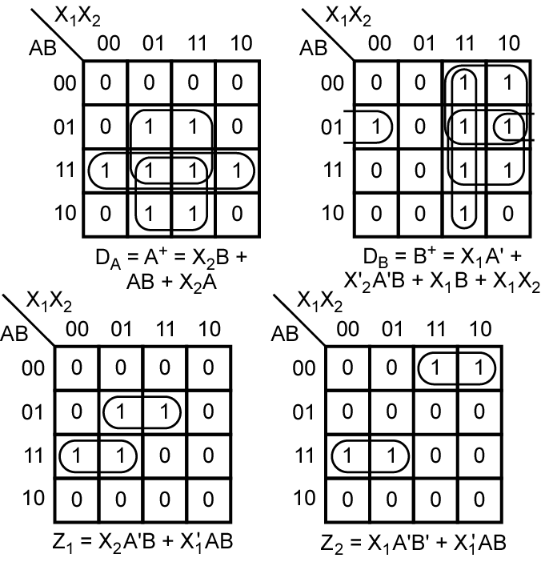
15.6 Derivation of FF Input Equations
Example #2: Derivation of FF Input Equations (Figure 15-10)
D FF Characteristic Equation:
Q⁺ = D
3. Derive the next-state maps from the transition table.
Notes:
43

Slide 44
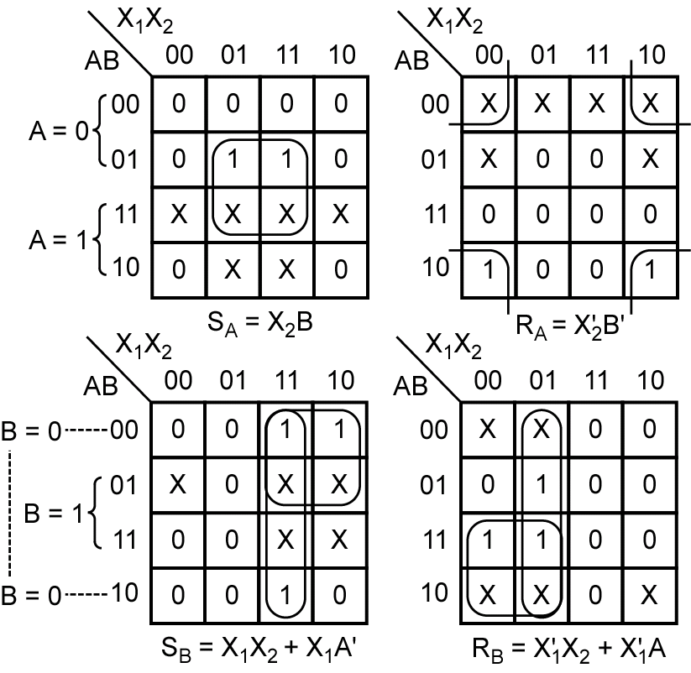
15.6 Derivation of FF Input Equations
Example #2: Derivation of FF Input Equations (Figure 15-11)
SR Excitation Table
Q | Q+ | S | R
0 | 0 | 0 | x
0 | 1 | 1 | 0
1 | 0 | 0 | 1
1 | 1 | x | 0
4. Derive the flip-flop input maps from the next-state maps;
determine the flip-flop input equations from the FF input maps.
Notes:
44

Slide 45
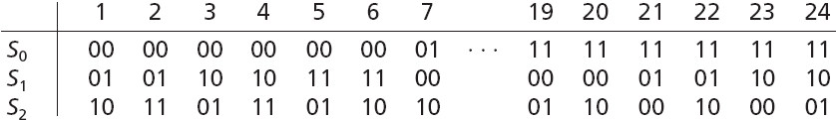
15.7 Equivalent State Assignments
Table 15-8 State Assignments for 3-Row Tables
Given a sequential circuit with three states and two flip-flops (A and
B), there are 4 × 3 × 2 = 24 possible state assignments for the three
states.
Notes:
45

Slide 46
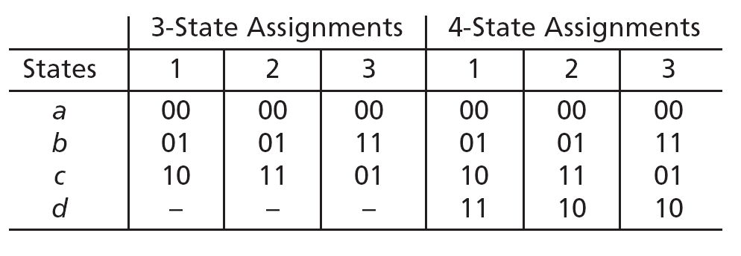
15.7 Equivalent State Assignments
Table 15-10 Nonequivalent Assignments for 3 and 4 States
When realizing a three-state sequential circuit with symmetrical flip-
flops (i.e. JK or SR), it is only necessary to try three different states
to be assured of a minimum cost realization.
Similarly, only three different assignments must be tried for four
states.

Slide 47
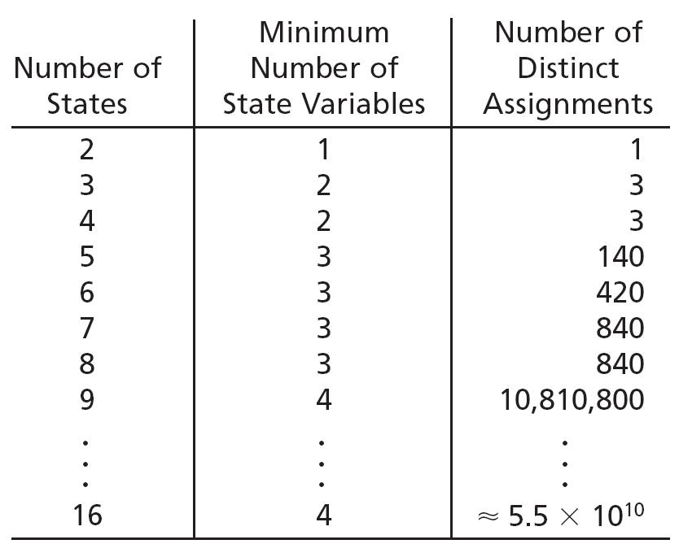
15.7 Equivalent State Assignments
Table 15-11 Number of Distinct (Nonequivalent) State Assignments

Slide 48
15.8 Guidelines for State Assignment
Trying all nonequivalent state assignments is not practical in most cases. The following guidelines are useful in making assignments which will place 1’s (or 0's) together in the next-state maps:
1. States which have the same next state for a given input should be given adjacent assignments.
2. States which are the next states of the same state should be given adjacent assignments.
3. States which have the same output for a given input should be given adjacent assignments.
Notes:
48

Slide 49
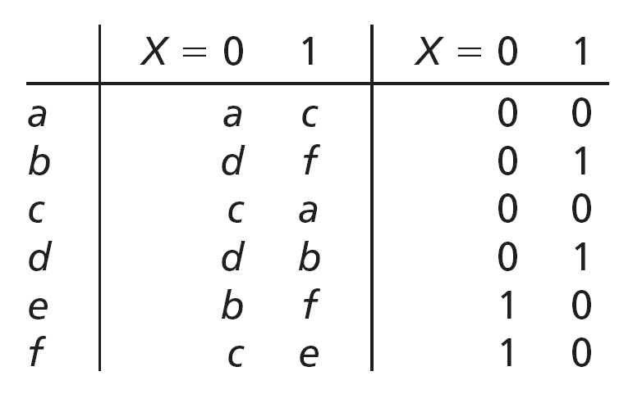
15.8 Guidelines for State Assignment
Figure 15-16(a) State Table and Assignments
States which have the same next state for a given input should be given adjacent assignments.
States which are the next states of the same state should be given adjacent assignments.
States which have the same output for a given input should be given adjacent assignments.

Slide 50
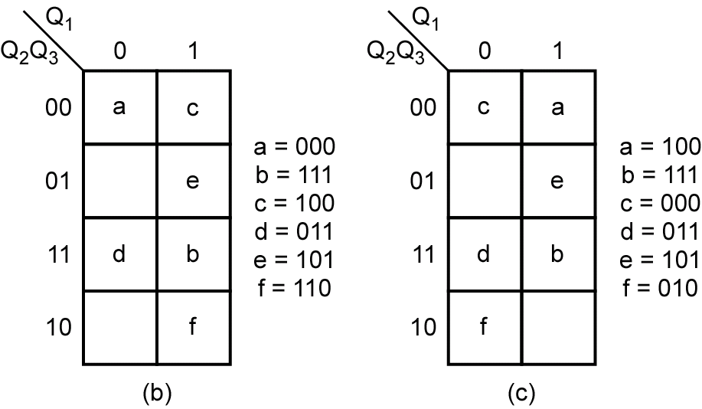
15.8 Guidelines for State Assignment
Based on the State Assignment Guidelines:
1. (b, d) (c, f) (b, e)
2. (a, c) (d, f) (b, d) (b, f) (c, e)
3. (a, c) (b, d) (e, f)
Figure 15-16(b)(c) State Table and Assignments

Slide 51
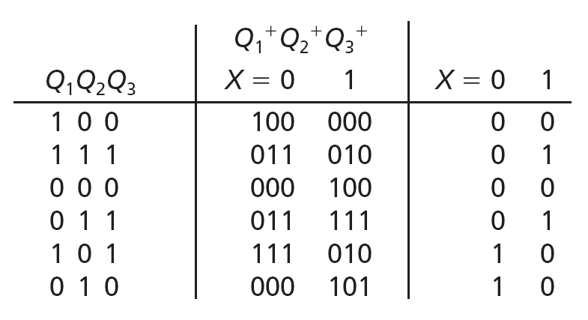
15.8 Guidelines for State Assignment
Table 15-12 Transition table for Figure 15-16(a)

Slide 52
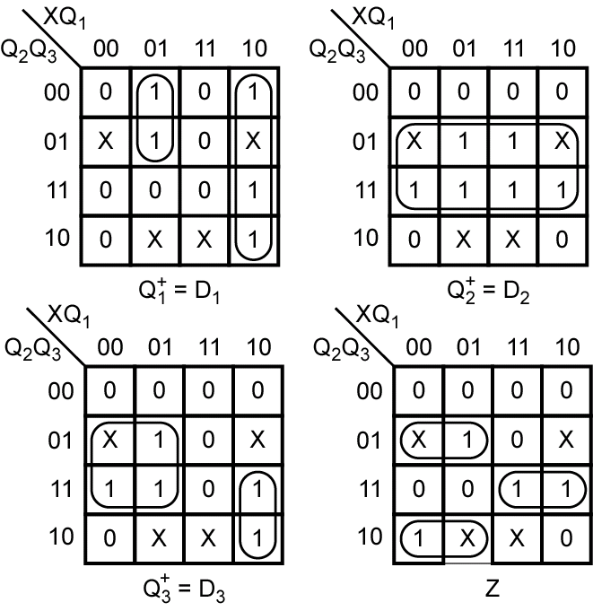
15.8 Guidelines for State Assignment
Figure 15-17 Next-State and Output Maps for Table 15-12

Slide 53
15.9 Using a One-Hot State Assignment
Sometimes reducing the number of flip-flops used is not as important as reducing the logic feeding into the flip-flops. Using a one-hot state assignment may help accomplish this.
The one-hot assignment uses one flip-flop for each state, so a state machine with N states requires N flip-flops. Exactly one of the flip-flops is set to one in each state.

Slide 54
15.9 Using a One-Hot State Assignment
For a four-state FSM, three possible state assignments are:
State | Binary | Gray-code | One-hot
S₀ | 00 | 00 | 0001
S₁ | 01 | 01 | 0010
S₂ | 10 | 11 | 0100
S₃ | 11 | 10 | 1000
# of FF | 2 | 2 | 4

Slide 55
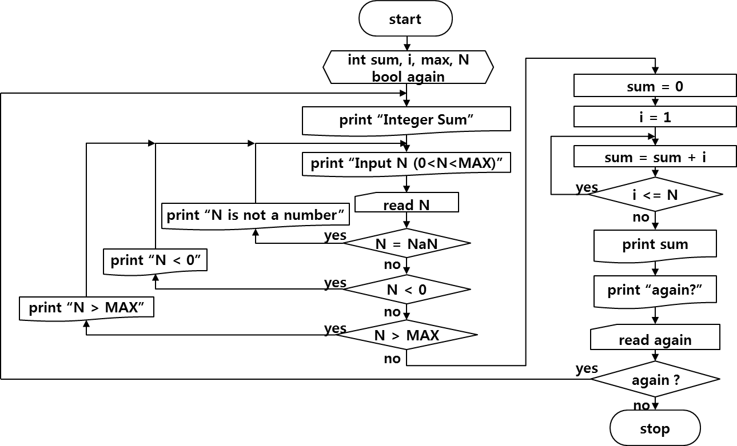
Logical SW Design: Final Recommendation
Integer 1~N Summation

